Slide 1
Faculty Express Near-Universal Concern That Student AI Use Undermines Original Writing and Critical Thinking
Week of April 20th
Elias Hord

Slide 2
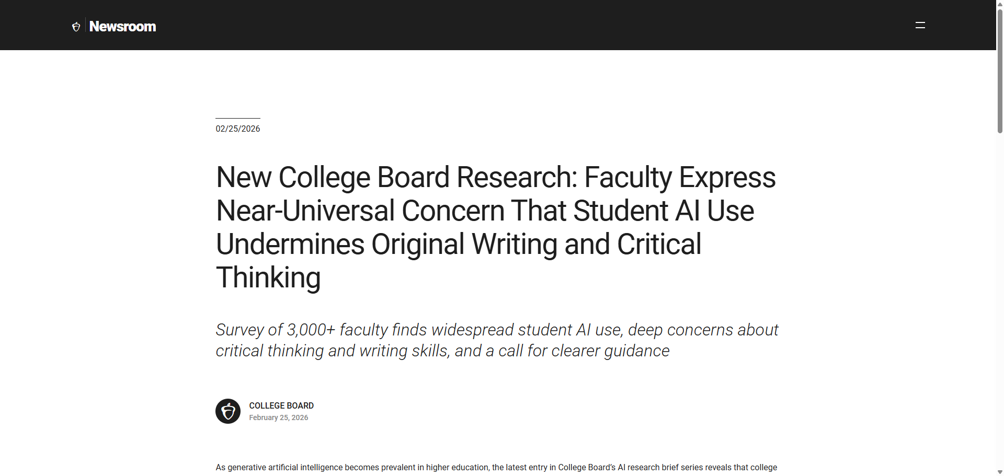
General Information
Article Publication: February 25th, 2026
https://newsroom.collegeboard.org/new-college-board-research-faculty-express-near-universal-concern-student-ai-use-undermines

Slide 3
Main Findings and Arguments
The College Board research reveals near-universal concern among faculty about student use of AI in academic work, particularly generative AI tools.
A major finding is that AI use is believed to undermine core academic skills, especially:
Critical thinking
Original writing
Deep engagement with course material
Large majorities of faculty (around 84% or more) say AI makes students more dependent on technology and less likely to think independently.
Faculty also express strong concern about academic integrity, including plagiarism and difficulty distinguishing student work from AI-generated content.
The article argues that educators are in a transitional moment, trying to balance:
Preserving traditional learning goals
Preparing students for an AI-integrated workforce

Slide 4
Broader Implications for Society
The findings suggest a potential shift in how knowledge and skills are developed, with AI possibly replacing rather than supporting human cognition.
If reliance on AI continues unchecked, society could face:
A decline in critical thinking and creativity
Reduced ability for individuals to analyze, problem-solve, and communicate independently
There are growing concerns about trust and authenticity, not just in education but across professional fields where AI-generated work may blur authorship and accountability.
The research highlights a broader societal challenge: how to integrate AI responsibly without eroding foundational human skills.
It also points to the need for new norms, policies, and ethical frameworks governing AI use in learning and work environments.

Slide 5
Relevance or Potential Influence on the Construction Industry
Although the article focuses on education, the implications strongly apply to construction, which increasingly uses AI for:
Project planning
Design optimization (e.g., BIM systems)
Cost estimation and scheduling
Key potential impacts include:
Workforce readiness concerns: Future construction professionals may enter the field with weaker problem-solving or technical reasoning skills if over-reliant on AI.
Skill gap risks: Construction requires hands-on judgment and situational awareness—skills that cannot be fully outsourced to AI.
Training and education shifts: Construction management programs may need to:
Emphasize applied learning and real-world problem solving
Teach responsible AI use, not just technical adoption
Safety implications: Over Reliance on AI-generated plans or analyses without critical evaluation could increase risks on job sites.
On the positive side, the article indirectly supports the idea that:
AI should be used as a tool to augment human expertise, not replace it
Industries like construction must balance efficiency with human judgment

